Slide 1
Texas Expansion Analysis

Slide 2
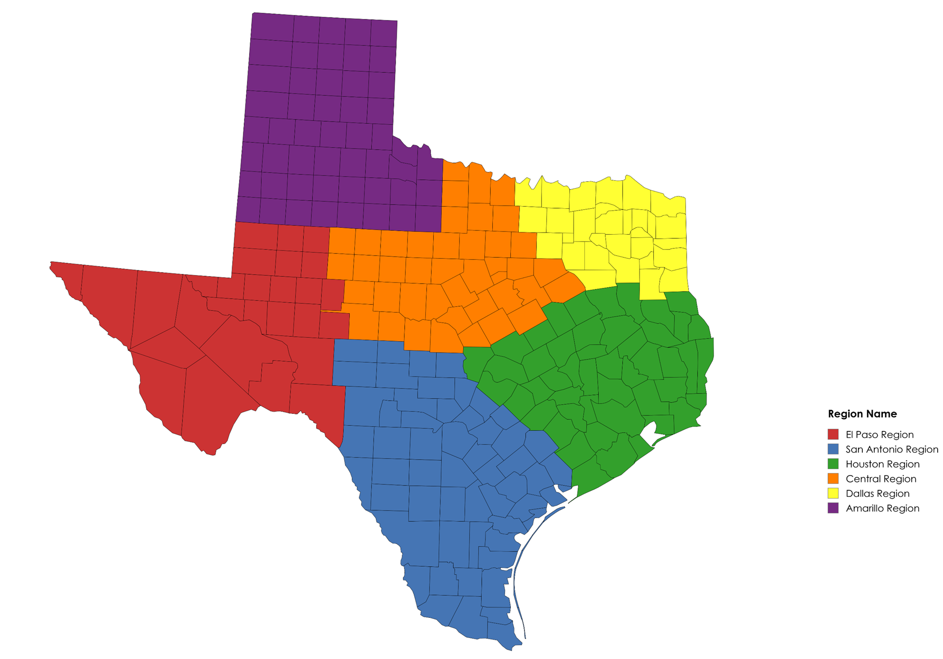
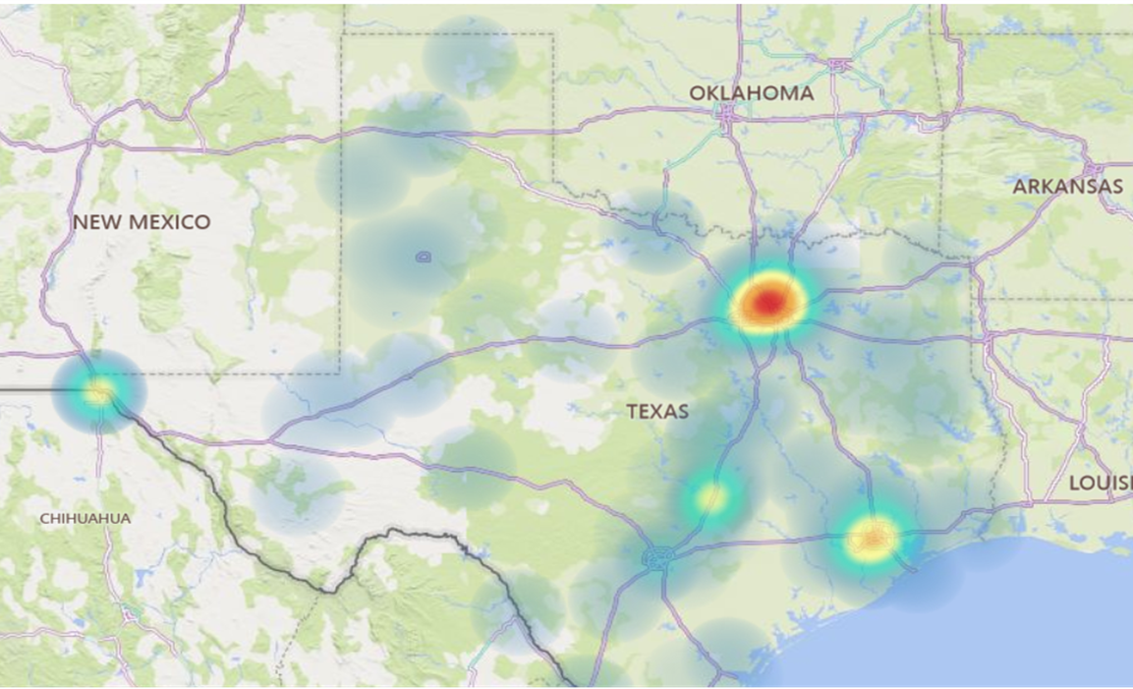
Approach for Analysis
Using Heatmap data to determine regions best suited for new installer.

Slide 3
Approach for Analysis
Assumptions Made

Slide 4
Approach for Analysis
Assumptions Made
Overall
Every crew uses 4 people
Each crew members gets their own hotel
Install length of 2 days + 1 travel day (3 hotels)
Travel Expenses
Travel from Elgin – M&S at $21/hr | Travel from Tomball – JSP at $17/hr
Travel for Wenger based off of living location assumed in assumptions
Used 2023 data for # of installs per region
Hourly Rate Savings
M&S $42/hr | JSP $38/hr | Wenger $30/hr
Texas Union Rate $38.95 total package ($29.27 hourly | $9.68 fringe)
Employee Benefits
Benefit calculations based off of 2,080 hours per year @ hourly rate * 30%
Assumed at 40 hours/week (both office and installer)
I have NOT factored in unemployment taxes
Depreciation
Van purchase price depreciated over 5 years
Misc Expenses
Wenger Installer $60 per day per diem
$100 per install for consumables for Wenger Installer (anchors, etc)
Cell phone stipend $80 per month
No new Fastfield licenses needed
Additional Head Count
2 new office staff needed - $60,000 per year each
Operating Expenses
$200 factored in per year to account for future computer costs
Yearly insurance/registration cost for new vehicles NOT factored in
Difference in Overhead allocation between how we calculate 3rd parties vs Wenger Installers is NOT factored in.
Not factoring in any office/storage warehouse leasing that would be needed
Capital Expenses
Purchase price of latest van used - $75,000
Initial tool invest for installer - $1,500
New laptops and printers - $800 for computer, $200 for printer

Slide 5
Cost Implications of Wenger vs. Third-Party Services
Cost Per Install – JSP $6,832, M&S $7,626, Wenger $7,990

Slide 6
What’s Next?
Background:
Significant bonds were passed in the El Paso area several years ago.
These bonds impacted our margins from 2021 to 2023, leading to constrained profitability.
Wenger’s historical approach has been reactive.
Future State:
Transition to a proactive strategy to anticipate and respond to future bond activity.
Align Sales and Installations teams more closely with bond timing and quoting activity to avoid unexpected resource shortfalls and improve capacity planning.
Action Steps:
Collaborate more effectively with Sales to stay informed on future bonds and assess their impact on our business operations.
We missed the opportunity to reposition crews to El Paso, which affected our ability to manage the increased volume effectively.
It is critical that we establish a system for early identification of bond approvals to prepare for future demand and adapt operational strategies for sustained success.
Focus on where we are going, not where we have been.

Slide 7
Texas Totals with 3rd Party Breakouts
Texas Total
M&S Total
JSP Total

Slide 8
Texas Totals with 3rd Party Breakouts
Texas Total
M&S Total
JSP Total

Slide 9
THANK YOU.

